Slide 1

NAIROBI HEALTHCARE ACCESS

Slide 2
An In-Depth Analysis of Healthcare Accessibility in Nairobi

Slide 3

Meet the Team
Kelvin Mwenda
Morgan Thiuri
Joshua Munyoki
Martin Onyango

Slide 4




Analysis
Facility type and availability
Ownership and operational status
Sub-county and facilities
Ownership and beds availability
Population and facility distribution
The goal of the analysis will be among other factors, to establish whether there exists a relationship between the above mentioned factors .

Slide 5
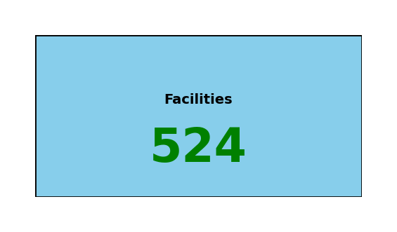
Facilities distribution in Nairobi
The county has a total of 524 Health facilities. Out of this, 42% are Public Facilities.
Not Operational
Operational
Pending
About 65% of the operational facilities have operations daily, Health facilities.
Weekend Operations
24-hr Operation
Special Services

Slide 6
Private and Public Hospital Listings
Medical
clinics
Special
Services clinics
Community Based hospitals
County Hospitals
58%
Private
Public
Private
Medical
Centers
Midwives
/Maternity Homes
Referrals
Local Hospitals
58 % of health facilities are private Entities
42%
Private facilities
Public Facilities
Facilities falling under this category are privately owed and fall in various categories such us medical centers
This are facilities that are owned by the government such as county referral hospitals.
Public
42 % of health facilities are public Entities

Slide 7
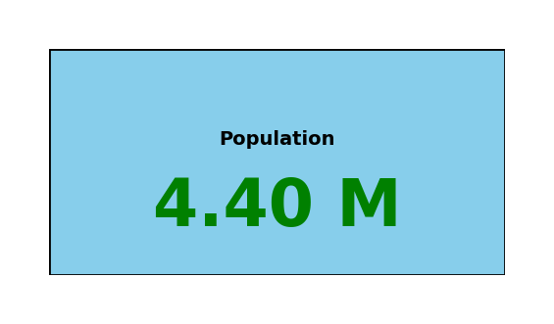
Population in Nairobi
The county population is around 4.4 Million, with the highest percentage of people living in Embakasi Sub-County

Slide 8
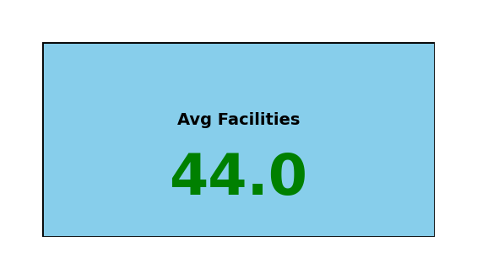

Facilities average distribution per sub county
Embakasi
46%
54%
Public
Facilities
Private
Facilities
On average, each Sub-county has a total of 44 Health facilities. Embakasi leads the way with the highest number of facilities while Mathare has 6 Health facilities only. In Embakasi, 46% of all Facilities are public.

Slide 9
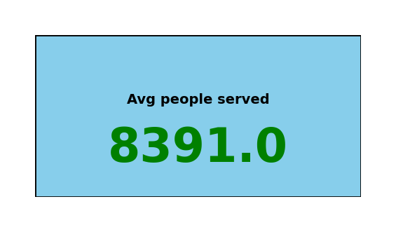

Average People served per facility
Embakasi
8309 people
On average, a facility serves atleast 8300 people. However, on the sub county level, Mathare leads the way on average, as over 34000 people depends on one facility.

Slide 10
Number of Beds and Cots In facilities
The number of beds and cots available in each sub-county, Mathare sub-constituency has the fewest number of beds while Langata constituencies has the highest .
Embakasi
Beds
Cots
635
111

Slide 11


Assumptions
Facility choice
Services offered
A resident considers the nearest health facility to get services.
Apart from special service's facilities, both private and public facilities offers the same services.
Population
Healthcare affordability.
The health centers serves the people of Nairobi only. The analysis does not consider citizens who from other counties
Citizens are evenly distributed within the county i.e the number of people who can afford the health services co-exist.
Agency of treatment
Everyone in the county require healthcare atleast once a month.

Slide 12
Findings
Number of People
There is significance difference in heartcare accessibility between sub-counties with more people than sub counties with fewer people.
Hospitals Distribution
The analysis established that there is significant difference in accessibility between Sub-counties with more hospitals and Sub-counties with fewer Hospitals.
Beds and Cots
Sub counties with more beds and cots are significantly different from those with fewer as far as accessing Healthcare facilities is concerned.

Slide 13



Recommendations
Hospitals
Sub-counties with fewer hospitals like Mathare , Kamukunji and Westland's should be the priority when it comes to building new Health facilities
Beds distribution
More beds should be added to Sub-counties Like Mathare and Roysambu.
Population
More hospitals should be Sub counties like. Kasarani and Embakasi should to match the best performing sub-county as far as patient-hospital ratio is concerned

Slide 14
EMBAKASI
Beds
Cots
Langata is the best performing sub county in bed-patient ratio. Embakasi needs 2442 more beds to match this ratio
Kamukunji is the best performing sub county in cot-patient ratio. Embakasi needs 747 more beds to match this ratio
Facilities
The best performing sub-county in hospital patient ratio is Starehe. 239 health facilities needs to be established to achieve this
Availability
Similar steps can be deployed to accurately establish the number of facilities needed in the remaining sub-counties.
All hospitals should be available 24/7 in Embakasi.

Slide 15
EMBAKASI SUB COUNTY
Beds
Cots
2442
747
This are the minimum requirements for Embakasi sub- county to be operating as the best Sub-county in Nairobi in the respective feature
Facilities
Availability
239
24/7

